Slide 1

ARVIO ABE SUHENDAR
PREDIKSI DIABETES DENGAN ARTIFICIAL INTELLIGENCE

Slide 2
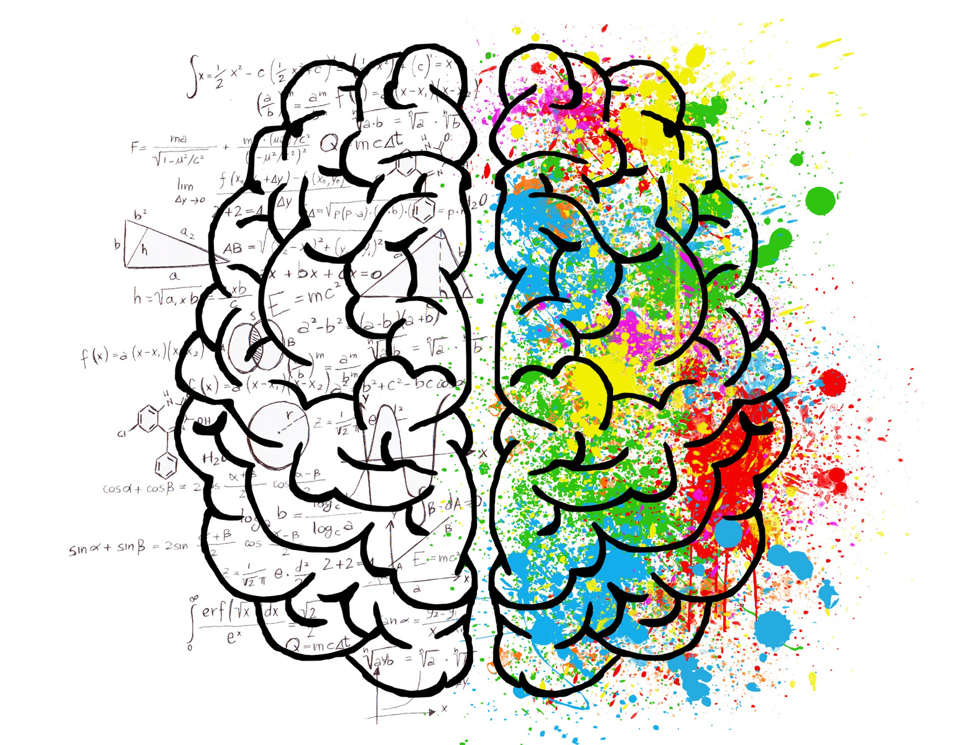
PAGE 02
PROBLEM STATEMENT
Diabetes is a very dangerous disease if left untreated in the human body because it is a chronic illness. If ignored, it can lead to various complications. Therefore, an application that can predict diabetes using Artificial Intelligence is needed to enable more efficient prediction. This would help patients quickly find out whether they have diabetes or not. If they do, it can be treated more promptly.

Slide 3
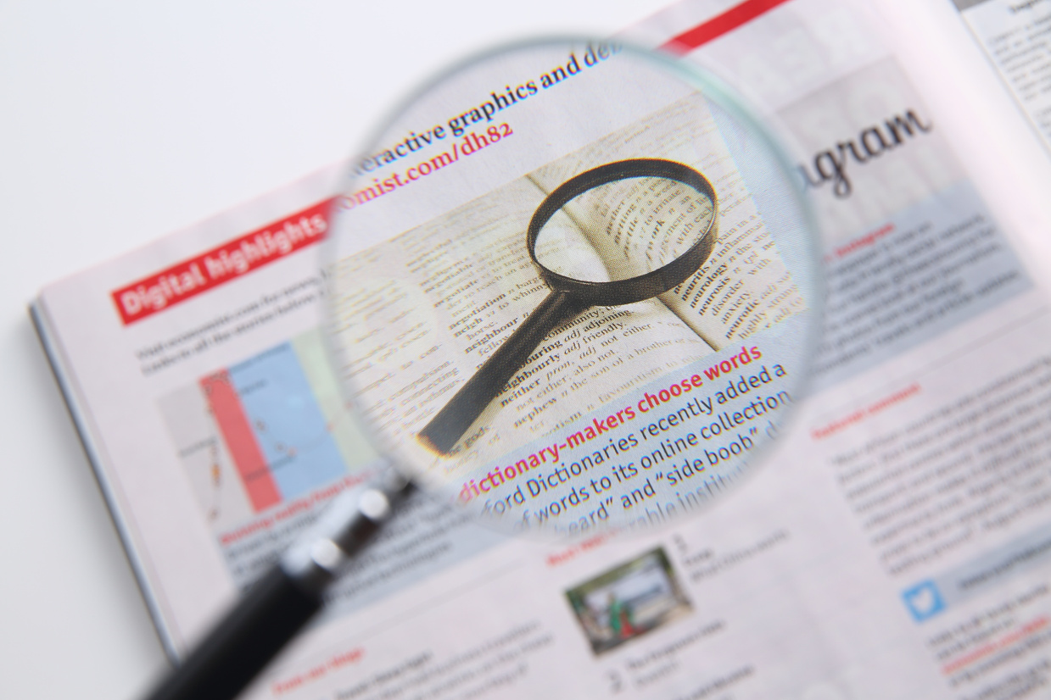
PAGE 03
OBJECTIVE
01
Predicting whether a patient has diabetes or not based on medical data
02
Can predict diabetes with early diagnosis with Artificial Intelligence

Slide 4

DATASET OVERVIEW
PAGE 04
Dataset : diabetes.csv
Total Records : 768
Features :
Pregnancies : the Number of pregnancies
Glucose : the Glucose level in blood
BloodPressure : the Blood pressure measurement
SkinThickness : the thickness of the skin
Insulin : the Insulin level in blood
BMI : the Body mass index
DiabetesPedigreeFunction : the Diabetes percentage
Age : the age
Target :
Outcome : the final result 1 is Yes and 0 is No

Slide 5

PAGE 05
TOOLS & LIBRARY
01
PYTHON
05
NUMPY
02
PANDAS
06
MATPLOTLIB
03
JOBLIB
07
SEABORN
04
SCIKIT-LEARN

Slide 6
PAGE 06
WORKFLOW
Read the dataset
Data preprocessing
Data analysis
Split data (train & test)
Save split data result in joblib
Train model
Model evaluation
Save model in joblib
Run the program

Slide 7
PAGE 07
DATA PREPROCESSING
01
02
03
04
DATA DUPLICATION
MISSING VALUES
VALUE THAT SHOULD NOT BE 0
OUTLIER

Slide 8
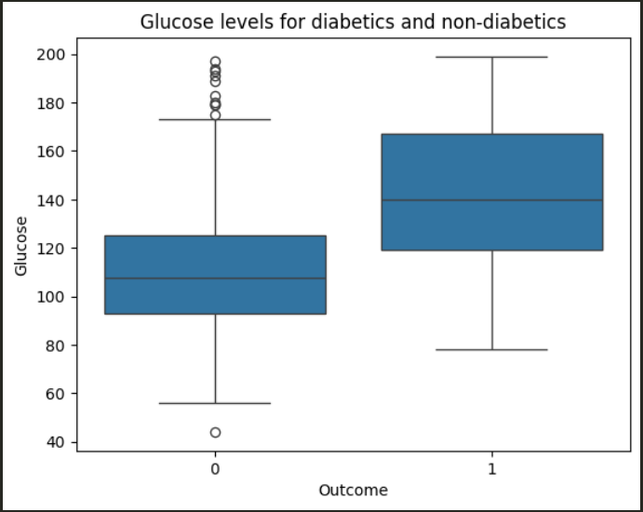
EXPLORATORY DATA ANALYSIS (EDA)
PAGE 08
Does Glucose level affect the possibility of having diabetes?
Patients with diabetes have higher glucose levels than patients without diabetes. This shows that blood sugar levels are an important factor in determining whether a patient has diabetes or not.

Slide 9
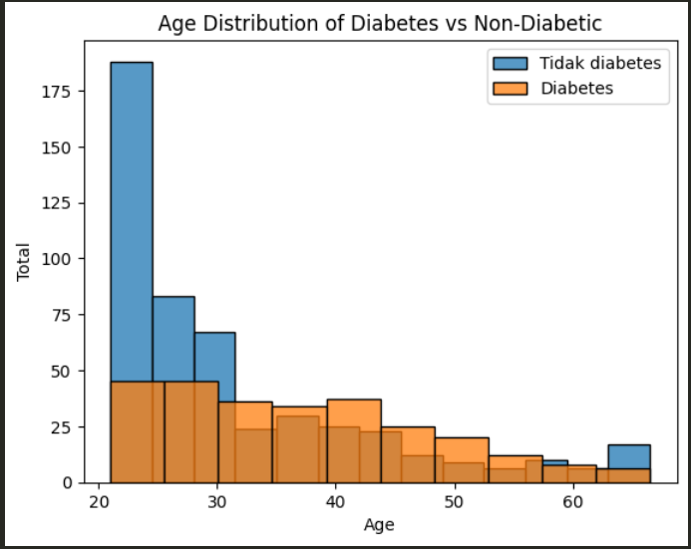
EXPLORATORY DATA ANALYSIS (EDA)
PAGE 09
What is the age distribution of patients with diabetes compared to those without?
Diabetes sufferers are more at the age of 30 to 60 and above. The least affected by diabetes are those aged 20 to 30.

Slide 10
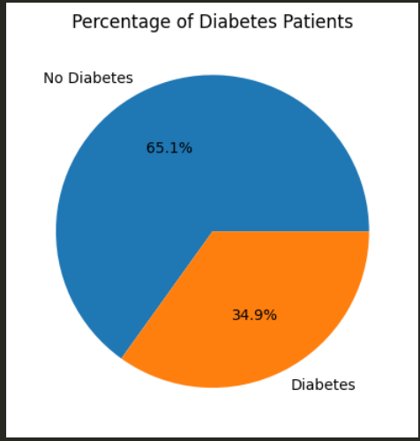
EXPLORATORY DATA ANALYSIS (EDA)
PAGE 10
What percentage of patients have diabetes ?
As many as 34.9% had diabetes so it can be concluded that more people did not have diabetes as much as 65.1%.

Slide 11
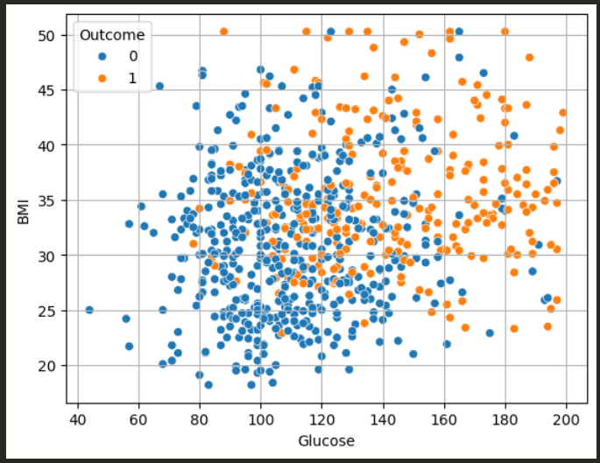
EXPLORATORY DATA ANALYSIS (EDA)
PAGE 11
How big a role do BMI and Glucose play in predicting diabetes ?
The graph shows that patients with high BMI and glucose values ​​have diabetes.

Slide 12
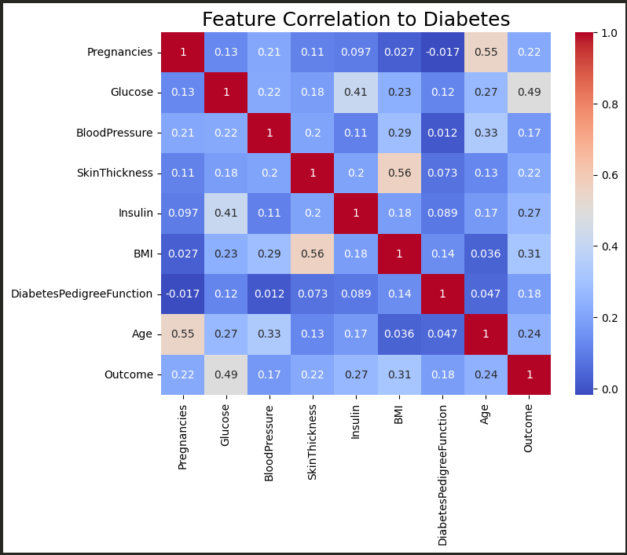
EXPLORATORY DATA ANALYSIS (EDA)
PAGE 12
Based on the correlation or feature importance results, which features contribute the most to diabetes prediction ?
The most correlated feature to predict diabetes is "Glucose" as much as 0.49 and the lowest is "BloodPressure" as much as 0.17. For the highest relationship is between "SkinThickness" and "BMI" as much as 0.56.

Slide 13
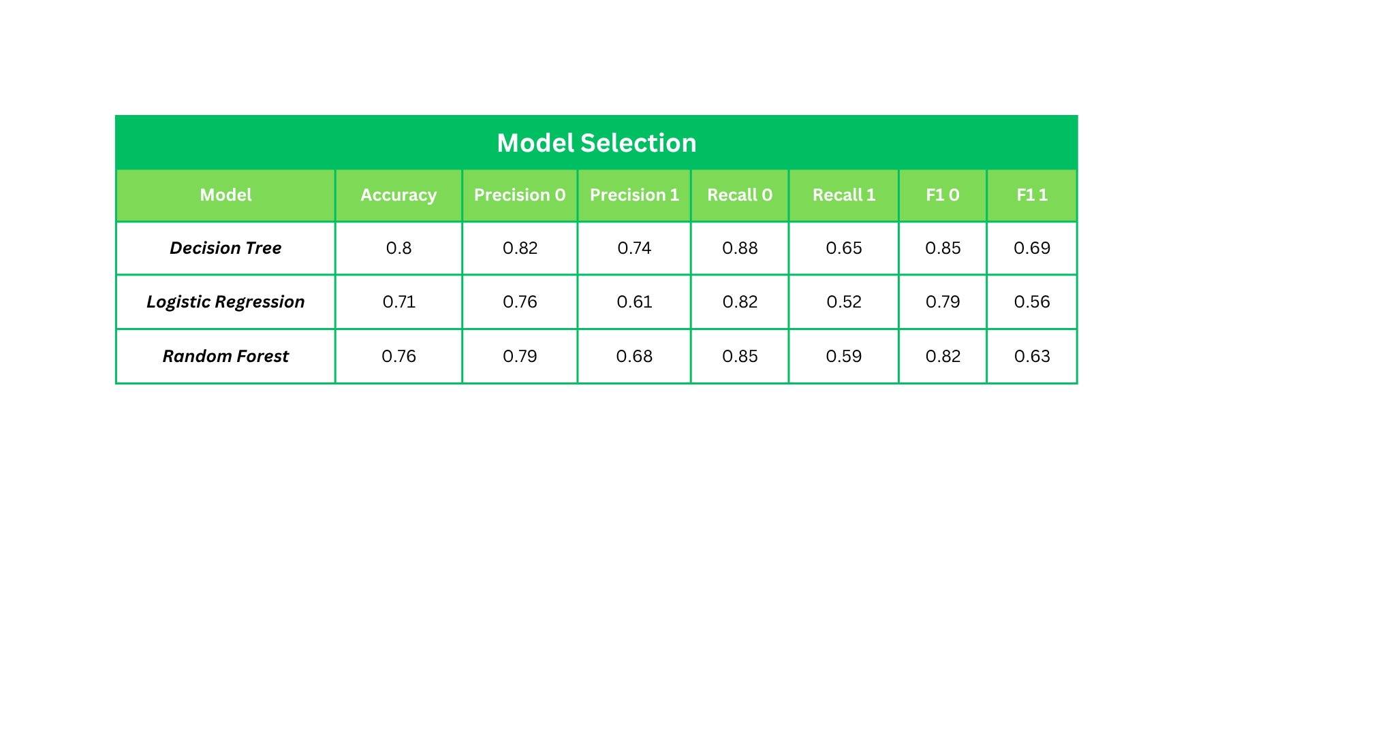
Classification Report
PAGE 13
The Decision Tree model is the best model because this model excels in all parts so this model is suitable for use in making predictions compared to other models. The model can provide an accuracy score of 0.8 so it can be said that the model can work well to predict diabetes. Non-diabetic patients are predicted more accurately than diabetic patients which can be seen from the results of precision and recall which are higher than diabetic patients.

Slide 14
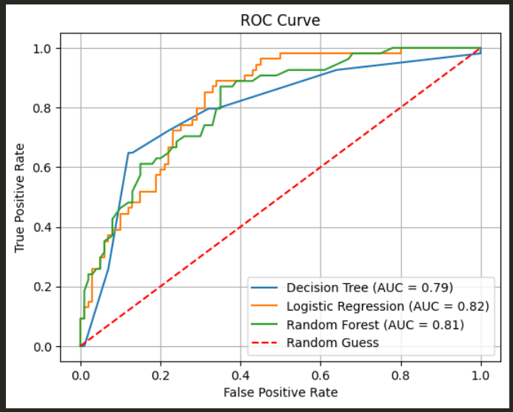
ROC-AUC CURVE
PAGE 14
All models have learned well, with values exceeding 0.75. However, the Logistic Regression model achieved the best AUC, with 0.82, although the differences between the models were small.

Slide 15
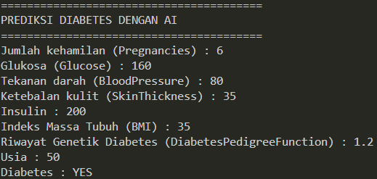
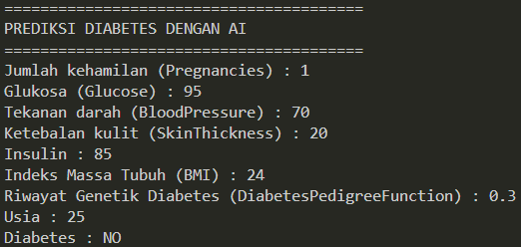
PAGE 15
PREDICTION RESULTS
Diabetes = YES
Diabetes = NO

Slide 16

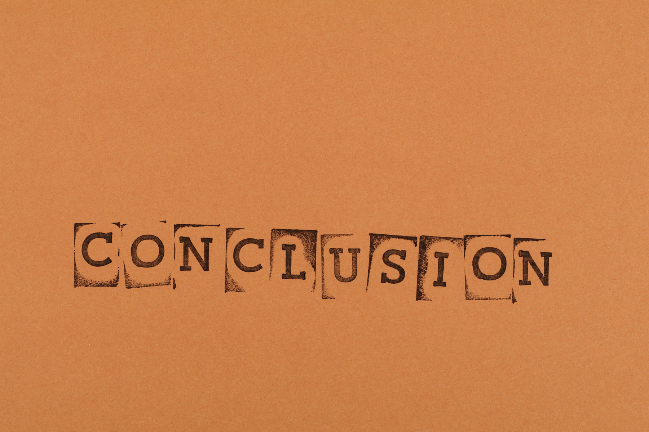
PAGE 16
CONCLUSION
Early detection through AI improves treatment response and patient outcomes.
AI models can effectively predict diabetes based on medical features.

Slide 17
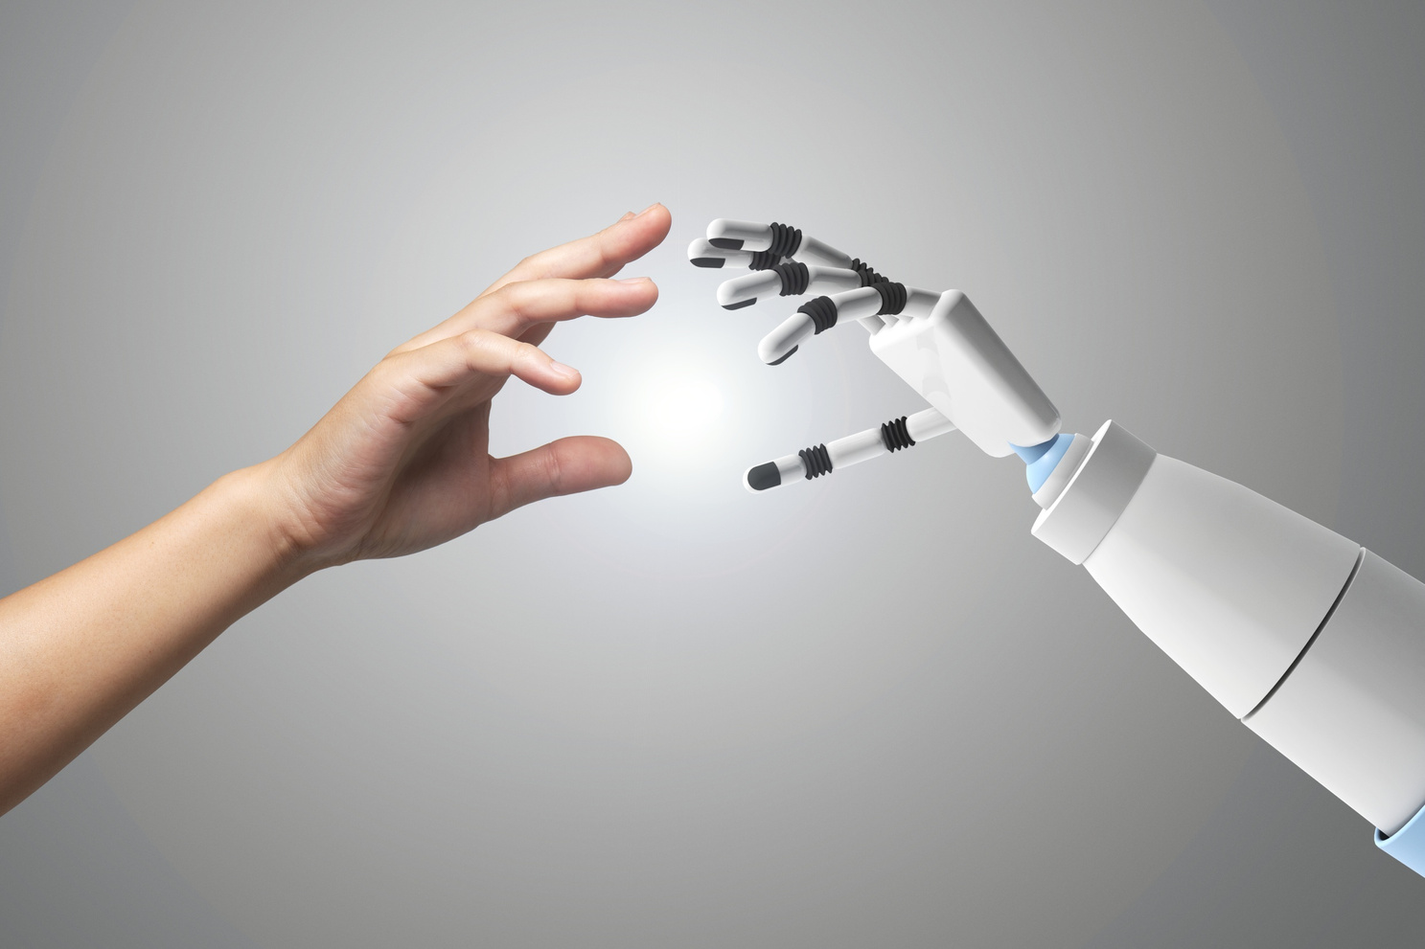

PAGE 17
FUTURE WORK
Model improvement (Hyperparameter Tuning)
Using bigger data

Slide 18

PAGE 18
ABOUT ME
I am currently learning and building a career in AI/ML. This project is my practice to build a simple python application. I want to further develop my skills in this field through existing projects.
LINKEDIN
linkedin.com/in/arvio-abe-suhendar/
EMAIL
4rv10suhendar@gmail.com
GITHUB
github.com/arvio1378

